Slide 1
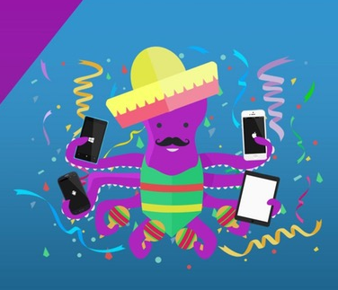
“Xamarin with MVVM”
Xamarin Fiesta – Manila
Event powered by: Philippines .Net Users Group
Mark Deanil Vicente
Programmer | Xamarin Lover
markdeanilvicente@outlook.com & mark@anynetworksystems.com
Viber +639299988313

Slide 2
Topics that we are going to tackle about
I - Basic understanding of Data Binding in Xamarin Forms
II - Xamarin with MVVM

Slide 3
Data Binding
Notes:
What makes up a “Native” mobile application? I am sure you have heard the “native” thrown around, but what does that really mean?

Slide 4
Data Binding
Allow properties of two objects to be linked so that a change in one causes a change in the other.
One of the most important markup extensions in Xamarin.Forms

Slide 5
Data Binding
DATA
BINDING

Slide 6
Data Binding
OBJECT
VIEW
DATA BINDING
(Binding Source)
(Binding Target)
OBJECT
UI ELEMENT
Property
Property (UI Property)

Slide 7
Data Binding
CustomerInfo Class
(Binding Source)
Label View
(Binding Target)
CustomerName
Text Property
CustomerAge
Text Property

Slide 8
Data Binding
The Main Benefits are:
Binding framework synchronizes automatically
No need to write bunch of save and update codes in your app
Changes in source are pushed to the target
Changes in target can be synchronized back

Slide 9
Data Binding
Establishing data binding in two step process:
The BindingContext (property target must be set to the source)
Binding Markup extension(Binding must established between the target and the source)
Binding markup extension can specify properties, including:
PATH
MODE
Property name
OneWay
TwoWay
OneWayToSource

Slide 10
Data Binding
Others Benefits are:
Data Conversion
Output Formatting

Slide 11
Before we begin, probably (~_^)
You already have at least basic idea about Data Binding and how it works
You are now ready to understand the basic concepts of MVVM
Even you already know the concepts of MVVM, you still like to know some knowledge of the pattern in Xamarin Forms.

Slide 12
Xamarin with MVVM
Notes:
What makes up a “Native” mobile application? I am sure you have heard the “native” thrown around, but what does that really mean?

Slide 13
From Bindings to MVVM
MVVM = Model-View-ViewModel
MVVM was invented with XAML in mind
View
ViewModel
Model
Data Binding
Presentation & Presentation Logic
Business Logic & Data

Slide 14
From Bindings to MVVM
View
ViewModel
Model
Label
Binding
CustomerName
CustomerName
Label
CustomerAge
CustomerAge
Notify Property Changed
Button
Command

Slide 15
From Bindings to MVVM
Some Important Benefits of MVVM:
Separation of concerns
Developers can create unit tests for the view model w/o using the view
Easy to redesign the UI of the app w/o touching the code because the view is implemented entirely in XAML

Slide 16
PCL & Xamarin Forms
- Live coding ¯\_(ツ)_/¯

Slide 17
Recommended Resources
MVVM Light framework (mvvmcross.com)
MVVM Cross framework (mvvmlight.codeplex.com)
Prism
Etc.

Slide 18
“There are no shortcuts in achieving real success. Only those who take rough roads are the ones able to achieved it.” -Me ¯\_(ツ)_/¯
© 2017 Xamarin Inc.
God bless and thank you for listening!
Mark Deanil Vicente
Programmer | Xamarin Lover
markdeanilvicente@outlook.com & mark@anynetworksystems.com
Viber +639299988313 | Instagram – deanilvincent3

